Slide 1

CENTRAL INSTITUTE OF TECHNOLOGY KOKRAJHAR
Computer Science & Engineering Department-2023
Application of Machine Learning based approach for Diabetes Prediction
Project Members: | Amarjeet Kumar Singh (202002021073) Bhagyashree Nath (202002022099) Nerswn Baglary (202002022089)
Project Supervisor: | Dr. Pankaj Pratap Singh Assistant Professor Dept. of Computer Science and Engineering
Machine Learning based approach for Diabetes Prediction
April 24, 2023

Slide 2
OVERVIEW
Introduction
Problem Statement
Motivation
Related Works
Proposed Mechanism
Machine Learning based approach for Diabetes Prediction
April 24, 2023

Slide 3
INTRODUCTION
Diabetes : A chronic disease that affects millions of people worldwide
Economic burden of Type 2 Diabetes (T2D) on society has increased over time
Early prediction of diabetes and prediabetes can reduce treatment costs and improve intervention
Life Insurance policy can be suggested with the help of this work
Health check up data taken as subject under test
Machine Learning based approach for Diabetes Prediction
April 24, 2023

Slide 4
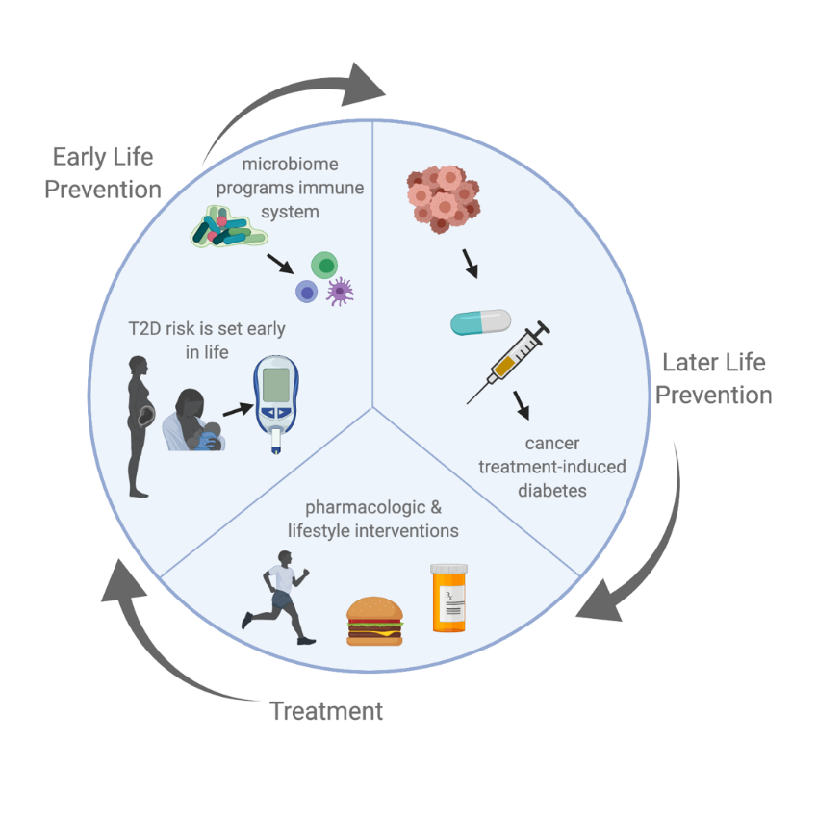
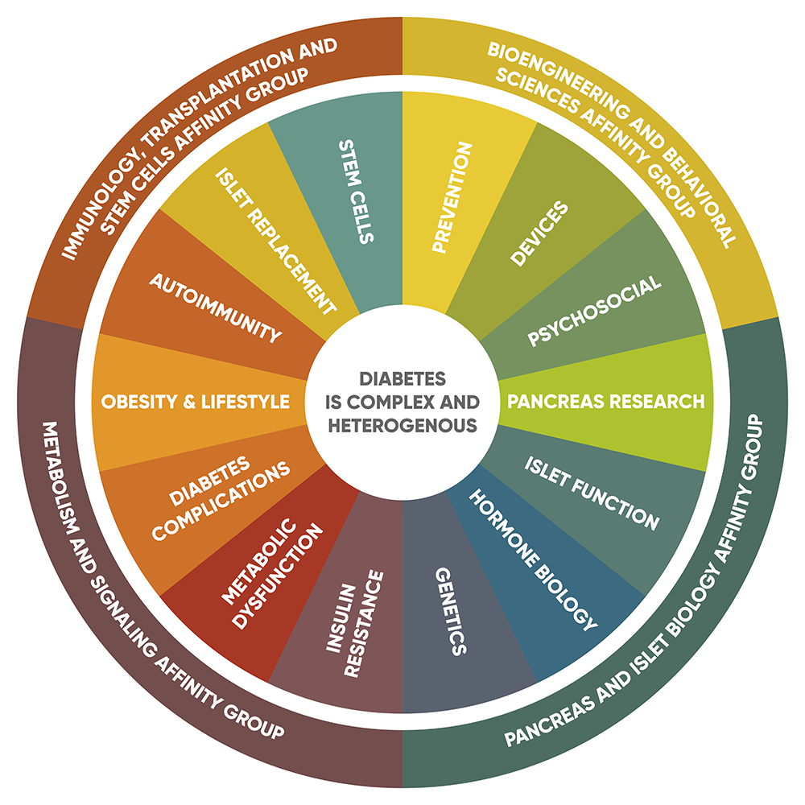
PROBLEM STATEMENT
Aim to reduce the death rate due to diabetes
Implementing latest technological advancements such as Machine learning & AI
Specific Life Insurance policy can be suggested to patient based on predicted result.
[Source: Stanford diabetes research center]
[Source: ouhealth.com ]
Machine Learning based approach for Diabetes Prediction
April 24, 2023

Slide 5
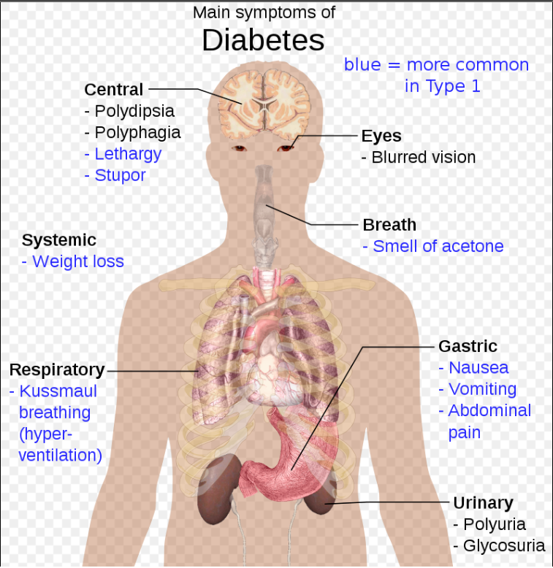
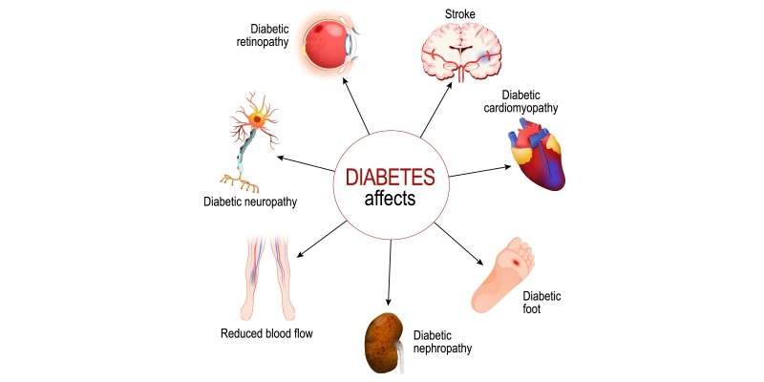
MOTIVATION
“ Trying to manage diabetes is hard because if you don’t, there are consequences you’ll have to deal with later in life ” - Bryan Adams
Sugar consumption: Too much sweetness is injurious to health
[Source: @Wikipedia]
[Source: rghospitals.com]
Machine Learning based approach for Diabetes Prediction
April 24, 2023

Slide 6
EXISTING WORK
Md. Maniruzzaman, Md. Jahanur Rahman, Benojir Ahammed and Md. Menhazul Abedin | Classifcation and prediction of diabetes disease using machine learning paradigm | 2020
Umair Muneer Butt, Sukumar Letchmunan, Mubashir Ali, Fadratul Hafinaz Hassan, Anees Baqir, and Hafiz Husnain Raza Sherazi | Machine Learning Based Diabetes Classification and Prediction for Healthcare Applications | 2021
Aishwarya Mujumdara , Dr. Vaidehi V | Diabetes Prediction using Machine Learning Algorithms | 2019
Machine Learning based approach for Diabetes Prediction
April 24, 2023

Slide 7
PROPOSED MECHANISM
Data collection from different sources
Pre processing of data before going through the model
Training model based on concept like SVM, random forest
Making application of prediction using result from model used
Health policy suggestion to patient based on result
Machine Learning based approach for Diabetes Prediction
April 24, 2023

Slide 8
Thank You
Machine Learning based approach for Diabetes Prediction
April 24, 2023

